Slide 1
Warning System for Drivers

Slide 2
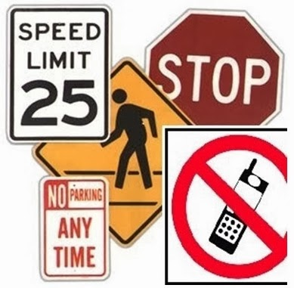
Introduction
Over 1.25 million road traffic deaths occur globally every year and majority of the accidents happen due to loss of concentration and violation of traffic rules.
The objective of the project is to ensure pedestrian safety and monitoring the vehicle speed and concentration of driver to prevent accidents.

Slide 3
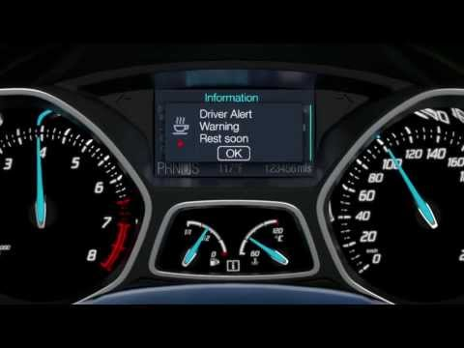
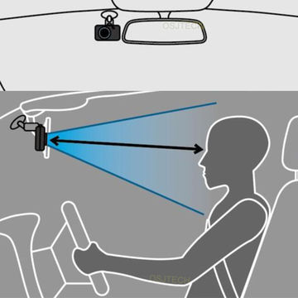
Problem Statement
To ensure pedestrian safety and preventing accidents by warning the driver by using vision based systems which sense the speed limit signs or sign boards and even monitor the drivers concentration level .

Slide 4
Key Features
Traffic sign detection and recognition from live video feed
Real Time Monitoring of speed
Blink rate and eye position is captured
Drowsiness detection
Automatic warning or alert to the driver

Slide 5
Solution Steps
Train a Convolutional Neural Network to classify traffic signs.
Detect and crop the Traffic signs from live video feed.
Apply image processing techniques – Grayscale and Binarization.
Apply OCR to recognize the text from the traffic sign.
Compare the detected speed with the actual speed of the car.
Drowsiness detection by monitoring blink rate and eye position.
Give warning or alert to the driver.

Slide 6
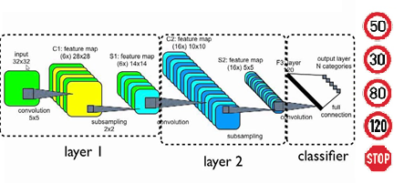
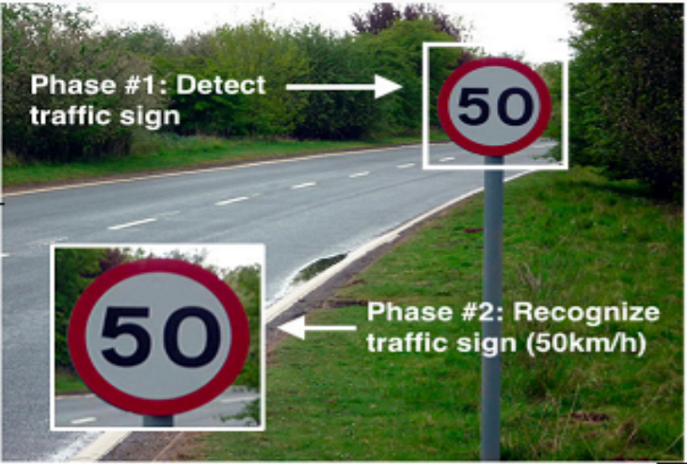
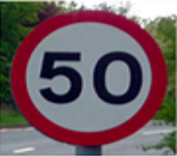



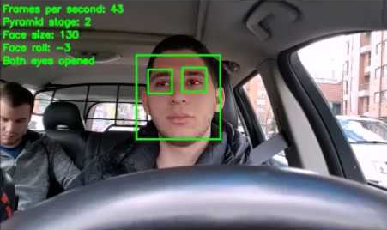

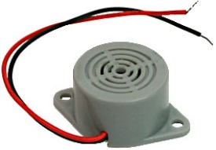
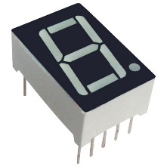
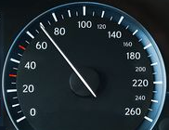


1. CNN to classify traffic signs
2. Detect traffic signs
from live video feed
3. Image processing –
Grayscale and Binarization
7. Warning or alert to
the driver
6. Drowsiness detection
by monitoring blink rate
and eye position
5. Compare detected
speed and actual
speed
4. Apply OCR

Slide 7
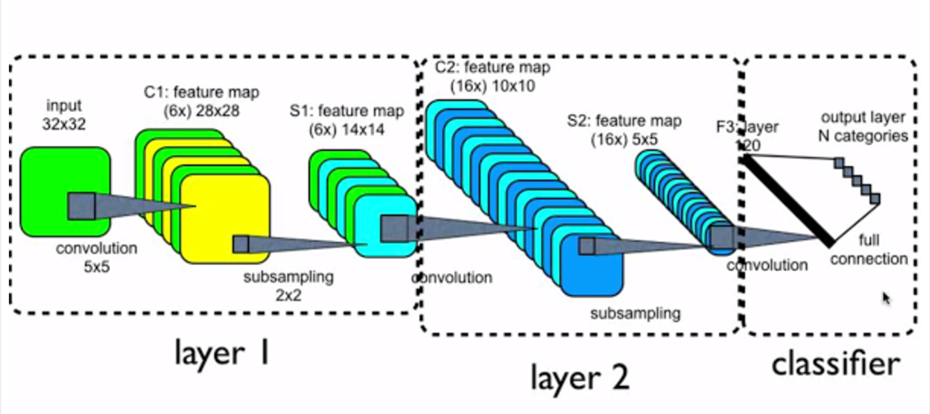
1. Train a Convolutional Neural Network to classify traffic signs using the Mapillary dataset.

Slide 8
2. Detect the traffic signs from the live video feed and classify it using the CNN.

Slide 9

3. Obtain the image of the detected traffic sign and apply gray scaling and binarization.
Cropped image
Binarization

Slide 10
4. Apply Optical Character Recognition to get the speed limit from the detected image.
Character segmentation

Slide 11
5. Check the speed of the car with the speed limit value detected from the traffic sign
Detected Speed Limit
Speed of Car

Slide 12
6. Eye position and blink rate of the driver is monitored in real time to detect the drowsiness of the driver.

Slide 13
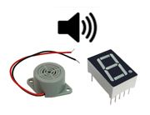
7. Warning is given to the driver in the form of a buzzer of a seven segment display.

Slide 14
Value Proposition
Accurate detection and recognition of traffic signs from live video feed.
Helps avoid road accidents due to violation of speed and potentially save lives.
Detects drowsiness of the driver in real-time.
Provides timely warning using a buzzer or seven segment display.
Works without internet connection.

Slide 15
Thank you

